Slide 1
NJROTC NS-4 Leadership and Ethics

Slide 2
Lesson 04.02 Setting the Example

Slide 3
Explain why setting the example and instilling a positive attitude in subordinates are important factors in becoming an effective leader.
Lesson Goal

Slide 4
Learning Objectives
State the influences that an officer’s behavior has on everyone’s performance.
Identify the appropriate response to peer pressure.
Explain the importance of knowing your subordinates.

Slide 5
Learning Objectives
State the influence that instilling a positive attitude in subordinates has on everyone’s performance.
Define the key term social fabric.

Slide 6
Do you believe a leader can instill a positive attitude in subordinates?
Yes
No
(NS4-U4L2:LQ1)

Slide 7
Setting the Example
Shipmates notice officers’ behavior, both on and off duty.
“An officer is on duty 24 hours a day.”
Officers need to set a good example for their subordinates.

Slide 8
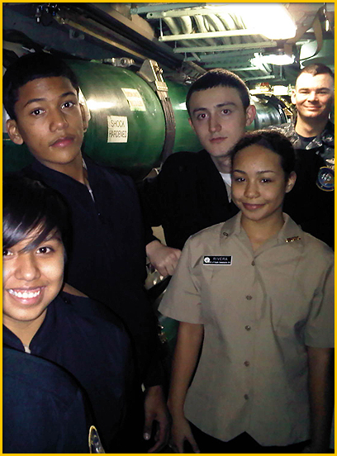
Peer Pressure
Working with and through others is a vital aspect of an officer’s job.
However, cooperation should not be an end in itself.
Peer pressure to “go along” or “get along,” when ethically or morally wrong, must be resisted.

Slide 9
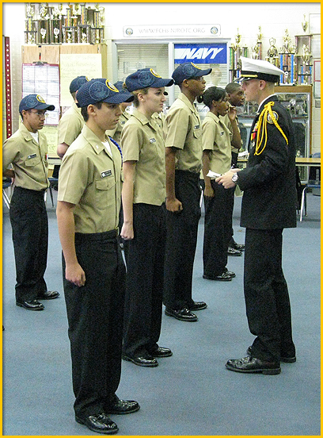
ADM Hayward on Principles
A leader needs to get along with people without compromising his beliefs.
A leader can stand firm on issues without creating a problem.
The finest officers deal with every human being as a human being.

Slide 10
Know your Subordinates
Being a leader includes:
Reconciling the principles of Naval Service with the reality of car payments and sick children.
Understanding the personal history and individual job of each subordinate.

Slide 11
Know your Subordinates
Being a leader includes:
Earning respect by knowing your subordinates.
Keeping respect with impeccable behavior.

Slide 12
Know Your People
Select Video to Start or Pause

Slide 13
ADM Zumwalt – Yom Kippur War
Leaders can find themselves in complex situations where duty is not clear.
In the 1973 war, ADM Zumwalt believed that equipment was not being provided to Israel quickly enough.
The president was not available to the chiefs or SecDef.

Slide 14
ADM Zumwalt – Yom Kippur War
ADM Zumwalt informed a senator who passed along the critical information.
The president ensured the equipment got to Israel in time to win the war.
ADM Zumwalt risked his career by speaking up, but followed his conscience to do the right thing.

Slide 15
Shipmates notice officers' behavior both on and off duty.
True
False
(NS4-U4L2:LQ2)

Slide 16
ADM Zumwalt - Vietnam
ADM Zumwalt was commander of naval forces in Vietnam.
To be a better leader, ADM Zumwalt spent time in ambushes and on patrols.
He came to understand the limitations and capabilities of his people and their equipment.

Slide 17
ADM Zumwalt - Vietnam
ADM Zumwalt used his knowledge from the operational inputs.
His people were better prepared for fast decisions.
They were better able to foresee the enemy’s actions and counteractions.

Slide 18
ADM Zumwalt - Vietnam
The key to good leadership is operational experience.
Experience educates leaders about subordinate operating units.
Leaders are more competent to help subordinates when they understand subordinates’ jobs.

Slide 19
ADM Zumwalt - Vietnam
Staff officers should make frequent visits to operating units.
Visits help you distinguish details that are essential to operational efficiency from unimportant details.

Slide 20
Instilling a Positive Attitude
ADM Zumwalt on morale:
After the Vietnam War, enlistment and reenlistment rates were down.
ADM Zumwalt was asked to address the problem.
He approached it from the standpoint of morale.

Slide 21
Instilling a Positive Attitude
ADM Zumwalt concluded:
The social fabric of the country was so bad that a revolutionary approach was needed.
It was the right time to “strike a major blow in behalf of equal opportunity.”

Slide 22
Officers should distance themselves from subordinates and their duties.
True
False
(NS4-U4L2:LQ3)

Slide 23
Positive Attitude: Practical Solutions
ADM Zumwalt on practical issues causing low morale:
High casualty rates were only part of the problem.
Soldiers complained more often about personal privileges like hairstyles and facial hair.

Slide 24
Positive Attitude: Practical Solutions
ADM Zumwalt’s solutions for low morale included:
Renewing Navy regulations that allowed neatly trimmed facial hair.
Providing comfort items in the barracks and Navy Exchange.
Ensuring lines were kept short.

Slide 25
Positive Attitude: Practical Solutions
Solutions were designed to give service men and women the feeling they were appreciated.
By the end of four years, reenlistment rates were above 30 percent, nearly quadrupled.

Slide 26
Positive Attitude: MCPON Billy Sanders
A positive attitude toward the Naval Service is crucial.
Good officers take responsibility for the things they maintain and the orders they follow.
Good leaders have the attitude: “We do the job because it needs to be done.”

Slide 27
Select the term which means the social environment in which a person or society operates.
Peer group
Nation
Social fabric
Morals
1
1
1
1
(NS4-U4L2:LQ4)

Slide 28
Lesson Summary
In this lesson you have:
Explained why setting the example and instilling a positive attitude in subordinates are important factors in becoming an effective leader.
Stated the influence that an officer’s behavior has on everyone’s performance.
Identified the appropriate response to peer pressure.

Slide 29
Lesson Summary
In this lesson you have:
Explained the importance of knowing your subordinates.
Stated the influence that instilling a positive attitude in subordinates has on everyone’s performance.
Defined the key term social fabric.

Slide 30
Leaderboard
Last
Slide
Points | Participant | Points | Participant

Slide 31
Whiteboard
Last
Slide

